Slide 1

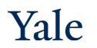
Deep Learning Theory and Applications Autoencoders Part 2
CPSC/AMTH 663

Slide 2
Outline
Non-linear dimensionality reduction review
Autoencoders
Sparse Autoencoders
Denoising Autoencoder
Contractive Autoencoder
SAUCIE
AAnet
VAE Preview

Slide 3
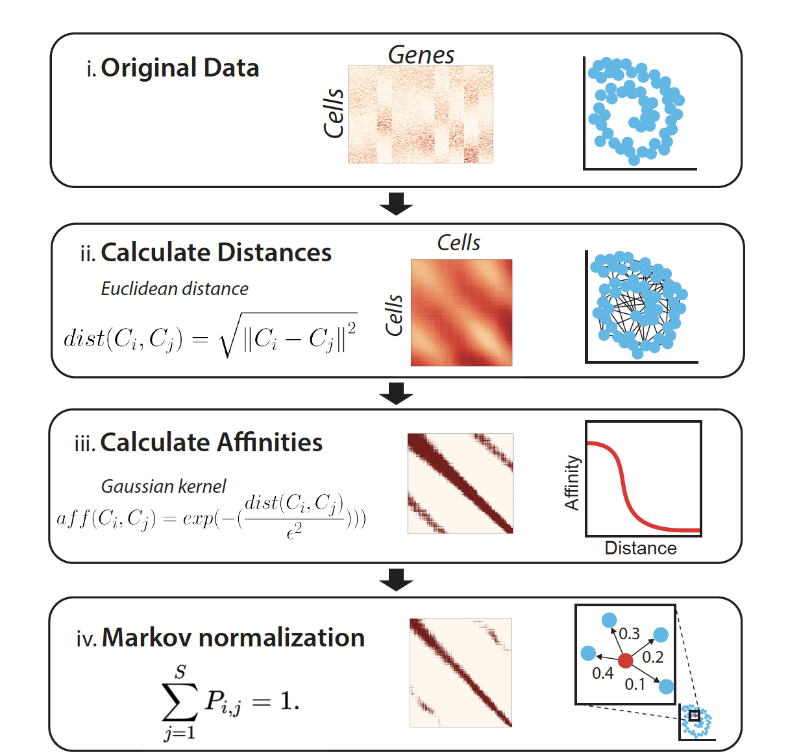

Non-Linear Dimensionality Reduction: Diffusion Map Steps

Slide 4
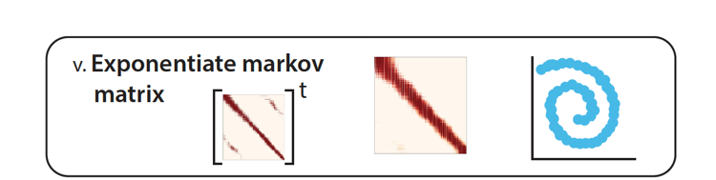
Continued
Eigendecompose

Slide 5
DM = Eigenvectors of Markov Matrix
The Diffusion MAP is the set of eigenvectors of the Markov matrix
Unlike PCA which finds the linear paths of greatest variation
Eigenvalues similar to PCA explain the extent of variation explained by the diffusion component
But first diffusion vector has a special meaning

Slide 6
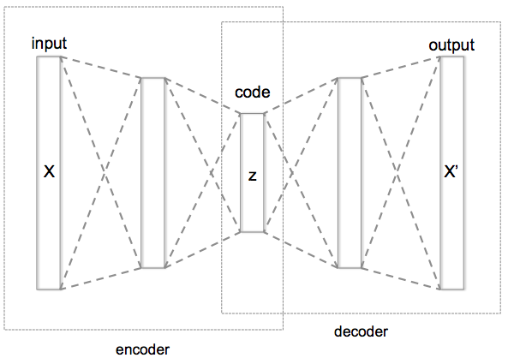
Autoencoder
Informational Bottleneck
[Hinton, Salakhutdinov, Science 2006]
Notes:
Here is an example of an autoencoder. The autoencoder tries to reconstruct its input, after passing it through the layers of the network.
Notice that there is an informational bottleneck here that we’ll talk about in a second.

Slide 7
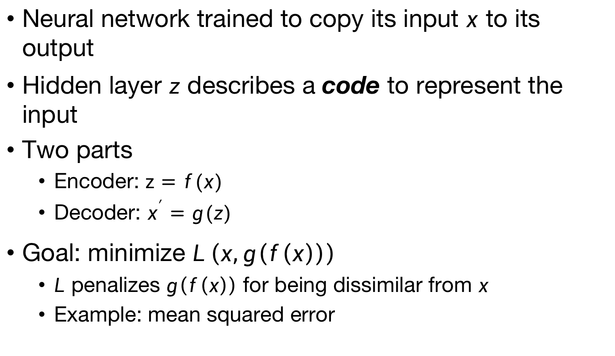
Autoencoder (AE)
Neural network trained to copy its input $x$ to its output
Hidden layer $z$ describes a code to represent the input
Two parts
Encoder: $z=f(x)$
Decoder: $x^{′}=g(z)$
Goal: minimize $L\left(x,g\left(f\left(x\right)\right)\right)$
$L$ penalizes $g\left(f\left(x\right)\right)$ for being dissimilar from $x$
Example: mean squared error
Notes:
Autoencoders are special types of neural networks that have been used to do unsupervised and semi-supervised settings
Recirculation compares activations of the network on the original input to the activations on the reconstructed input (considered more biologically plausible)

Slide 8
Autoencoder and Identity
Autoencoders could learn the identity without proper regularization/design
Design the AE so it cannot learn to copy the input perfectly
Restrict the AE to copy only approximately
Can prioritize certain aspects of the input
Examples
Restrict the size of the code (i.e. add a bottleneck)
Add regularization
Or alter penalty function to learn invariances

Slide 9
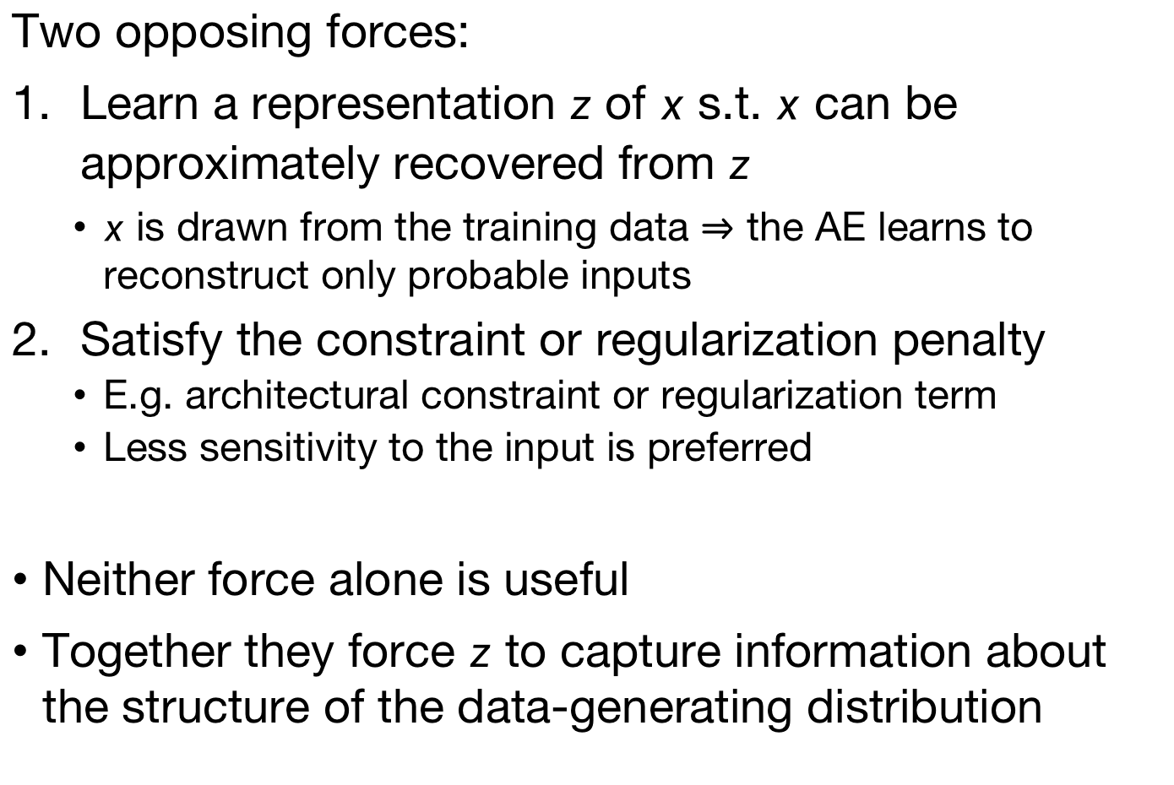
The Autoencoder compromise
Two opposing forces:
Learn a representation $z$ of $x$ s.t. $x$ can be approximately recovered from $z$
$x$ is drawn from the training data $⇒$ the AE learns to reconstruct only probable inputs
Satisfy the constraint or regularization penalty
E.g. architectural constraint or regularization term
Less sensitivity to the input is preferred
Neither force alone is useful
Together they force $z$ to capture information about the structure of the data-generating distribution
Notes:
Copying the input to the output is not useful alone, nor is entirely ignoring the input. Instead the two forces together are useful.
If the data-generating distribution concentrates near a low-dimensional manifold, this yields representations that implicitly capture a local coordinate system for this manifold

Slide 10
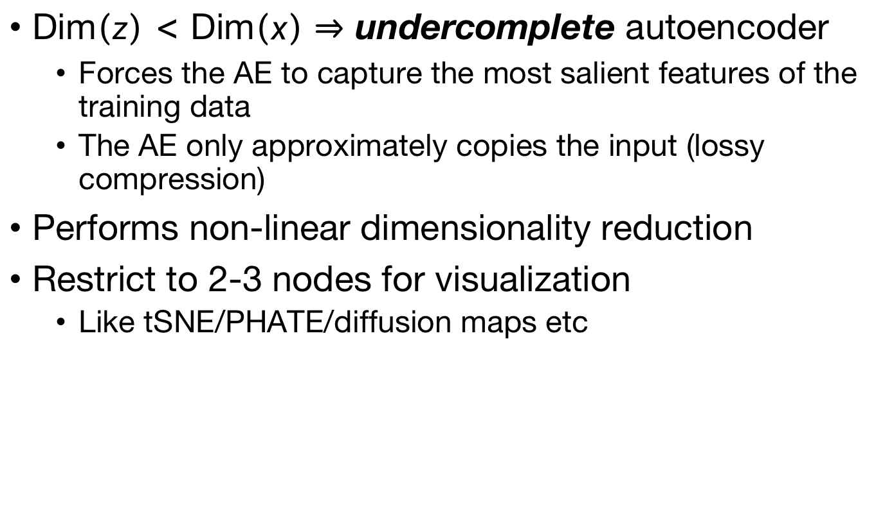
Restricting bottleneck
Dim$\left(z\right)<$ Dim$\left(x\right)⇒$ undercomplete autoencoder
Forces the AE to capture the most salient features of the training data
The AE only approximately copies the input (lossy compression)
Performs non-linear dimensionality reduction
Restrict to 2-3 nodes for visualization
Like tSNE/PHATE/diffusion maps etc

Slide 11
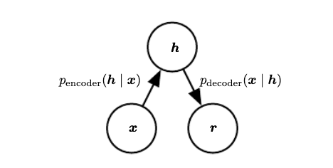
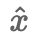
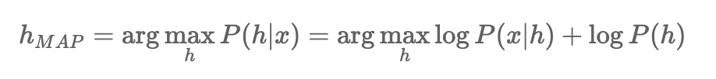
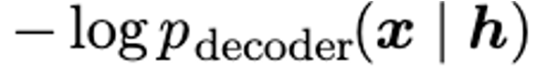
Stochastic view
Autoencoders can be thought of as latent variable models if the encoder is stochastic
Then the autoencoder training actually corresponds to minimizing negative log likelihood
hidden variable/hypothesis
posterior probability
likelihood
data/evidence
recustructed data

Slide 12
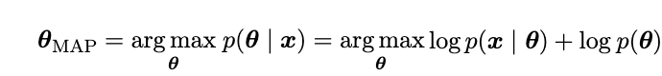
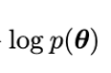
Regularizations
In this view regularizations can be thought of as adding a prior to the log likelihood estimate
This corresponds to maximum-a-priori inference
Here the regularization is providing something akin to
However not all regularizations are log of the likelihood term and can take the form of more generalized penalties

Slide 13
Regularizations
Regularized AEs modify the loss function to encourage desirable properties
Examples include:
Sparsity
Robustness to noise
Restrictions on gradient sensitivity
Notes:
Meaning, the complexity of mappings from layer to layer is too large
For linear case, they could learn to copy the input exactly

Slide 14
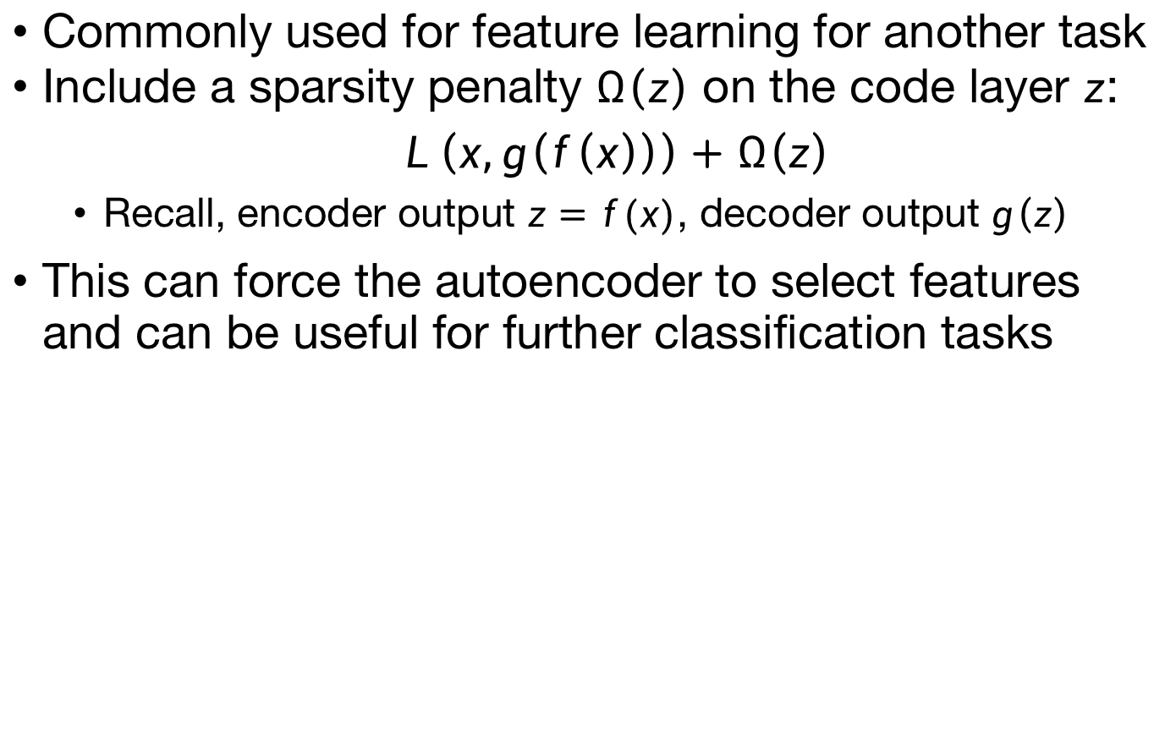
Sparse Autoencoders
Commonly used for feature learning for another task
Include a sparsity penalty $Ω\left(z\right)$ on the code layer $z$: $$L\left(x,g\left(f\left(x\right)\right)\right)+Ω\left(z\right)$$
Recall, encoder output $z=f(x)$, decoder output $g\left(z\right)$
This can force the autoencoder to select features and can be useful for further classification tasks
Notes:
Example is classification

Slide 15
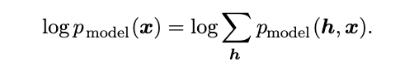
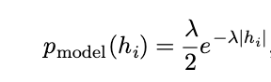
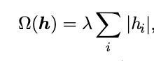
Sparse Autoencoders
Sparse autoencoders can also be interpreted as a maximum likelihood generative model with latent variables h
Joint probability
Example: L1 penalty
Equivalent to:
Penalty finds latent variables that explain output variables, i.e., has a connection to generative models

Slide 16
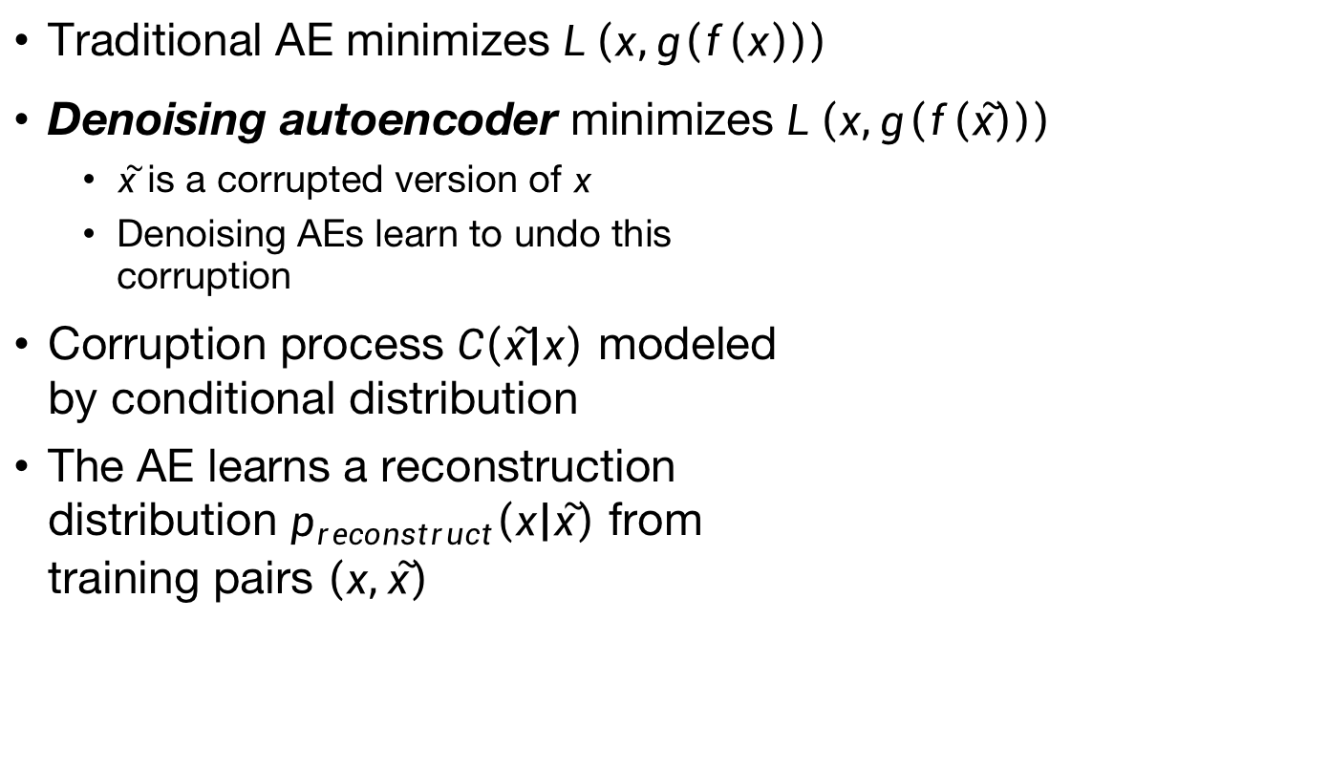
Denoising Autoencoders
Traditional AE minimizes $L\left(x,g\left(f\left(x\right)\right)\right)$
Denoising autoencoder minimizes $L\left(x,g\left(f\left(\tilde{x}\right)\right)\right)$
$\tilde{x}$ is a corrupted version of $x$
Denoising AEs learn to undo this corruption
Corruption process $C\left(\tilde{x} | x\right)$ modeled by conditional distribution
The AE learns a reconstruction distribution $p_{reconstruct}\left(x | \tilde{x}\right)$ from training pairs $\left(x,\tilde{x}\right)$

Slide 17
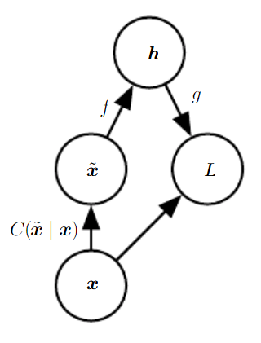
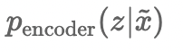
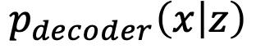
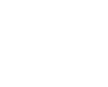
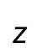
hidden variable
$$z$$
corrupted data
reconstructed data
original data

Slide 18
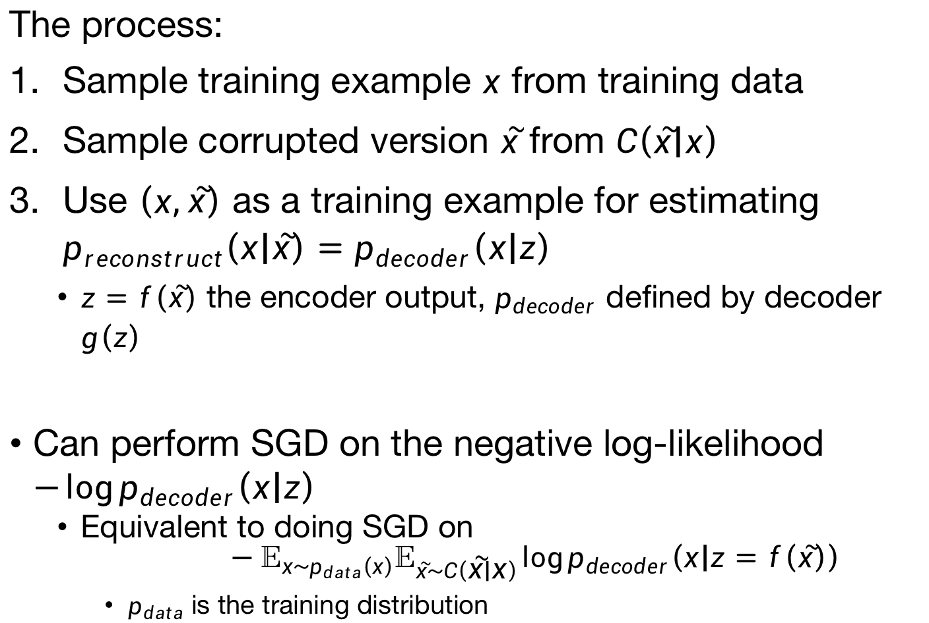
Denoising Autoencoders
The process:
Sample training example $x$ from training data
Sample corrupted version $\tilde{x}$ from $C\left(\tilde{x} | x\right)$
Use $\left(x,\tilde{x}\right)$ as a training example for estimating $p_{reconstruct}\left(x | \tilde{x}\right)=p_{decoder}\left(x | z\right)$
$z=f\left(\tilde{x}\right)$ the encoder output, $p_{decoder}$ defined by decoder $g\left(z\right)$
Can perform SGD on the negative log-likelihood $−\log{p_{decoder}\left(x | z\right)}$
Equivalent to doing SGD on $$−𝔼_{x\sim p_{data}\left(x\right)}𝔼_{\tilde{x}\sim C\left(\tilde{x} | x\right)}\log{p_{decoder}\left(x | z=f\left(\tilde{x}\right)\right)}$$
$p_{data}$ is the training distribution

Slide 19
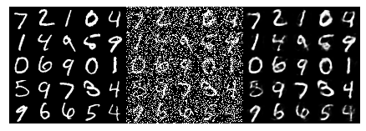
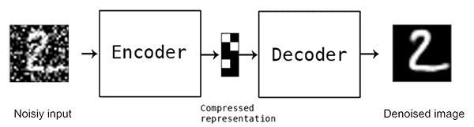
Denoising Autoencoder
data
corrupted data
reconstructed data
Add noise to the input while training and teach the autoencoder to remove noise
[Bengio ‘09]

Slide 20
Binary Codes
Information retrieval: find entries in a database that resemble a query entry
Train an AE to produce a low-dimensional binary code
Can store database entries in a hash table
Return all entries with the same binary code
Do this with saturated sigmoids on the final layer of the encoder
Add additive noise to the sigmoid nonlinearity during training
The AE fights the noise until saturation occurs
Code must be binarized
Can enhance binarization (preview: SAUCIE)

Slide 21
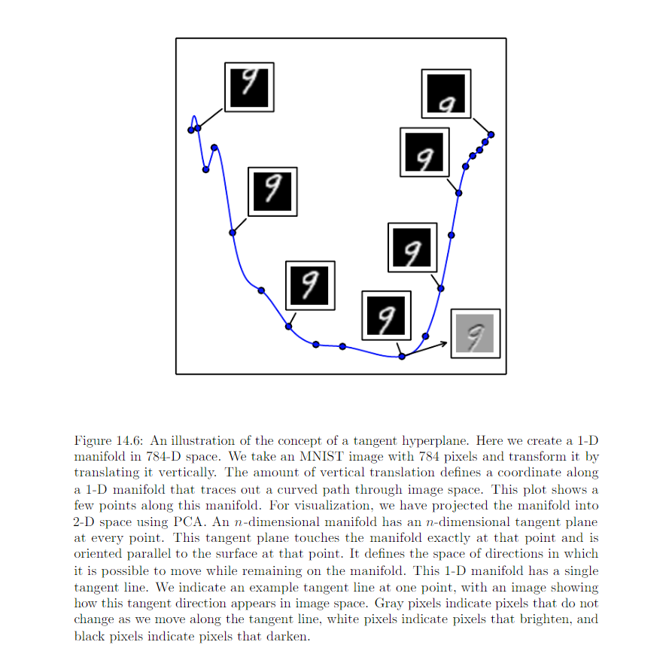
Manifold learning
Tangent plane: plane indicating the local directions of variation allowed on the manifold
Tangent plane
Notes:
Explain tangent plane wrt this manifold

Slide 22
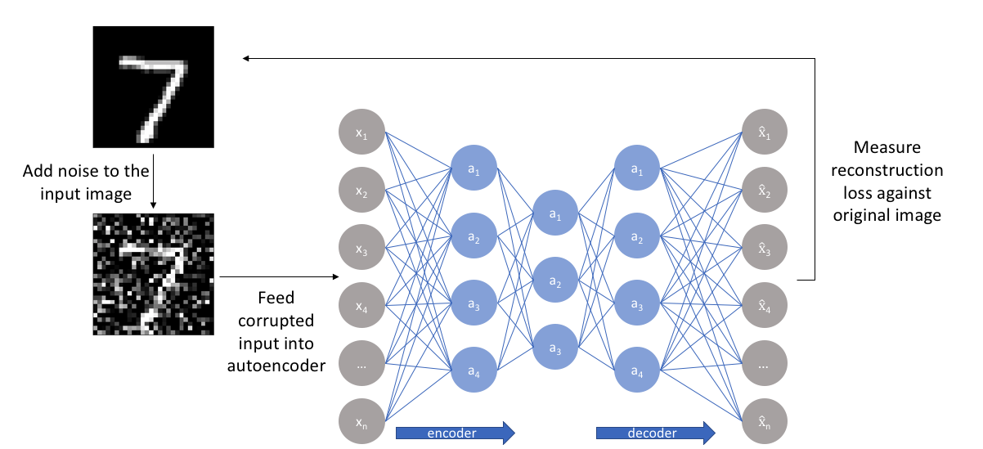
contractive Autoencoder

Slide 23
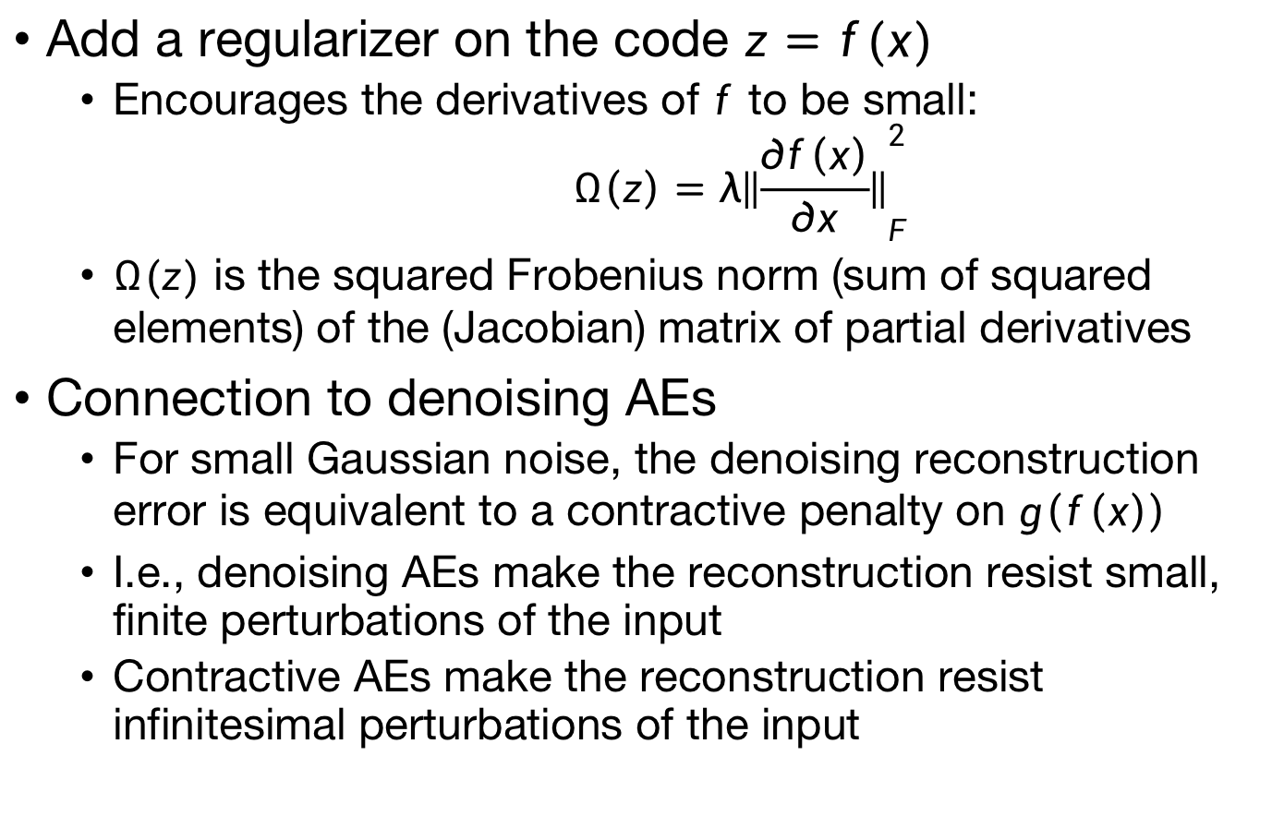
Contractive Autoencoders [Rifai 2011]
Add a regularizer on the code $z=f(x)$
Encourages the derivatives of $f$ to be small: $$Ω\left(z\right)=λ{\left\|\frac{∂f\left(x\right)}{∂x}\right\|}_{F}^{2}$$
$Ω(z)$ is the squared Frobenius norm (sum of squared elements) of the (Jacobian) matrix of partial derivatives
Connection to denoising AEs
For small Gaussian noise, the denoising reconstruction error is equivalent to a contractive penalty on $g\left(f\left(x\right)\right)$
I.e., denoising AEs make the reconstruction resist small, finite perturbations of the input
Contractive AEs make the reconstruction resist infinitesimal perturbations of the input
Notes:
Recall that x is a vector and so is f(x). Write this up on the board then?

Slide 24
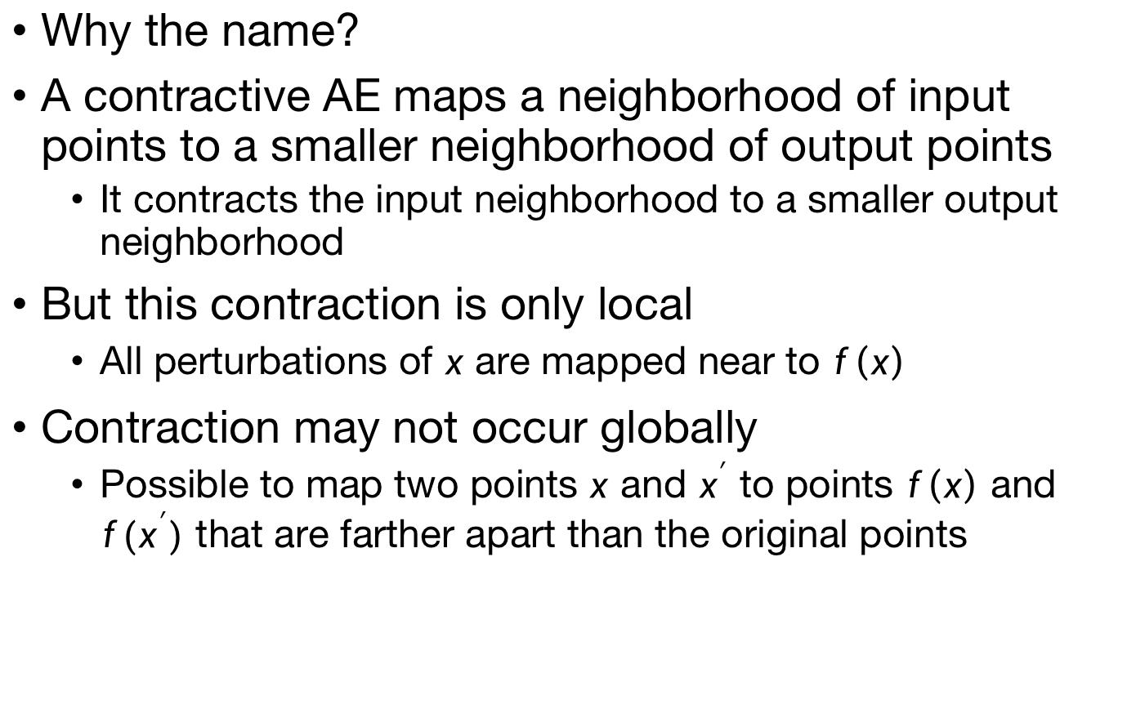
Contractive Autoencoders
Why the name?
A contractive AE maps a neighborhood of input points to a smaller neighborhood of output points
It contracts the input neighborhood to a smaller output neighborhood
But this contraction is only local
All perturbations of $x$ are mapped near to $f\left(x\right)$
Contraction may not occur globally
Possible to map two points $x$ and $x^{′}$ to points $f\left(x\right)$ and $f(x^{′})$ that are farther apart than the original points

Slide 25
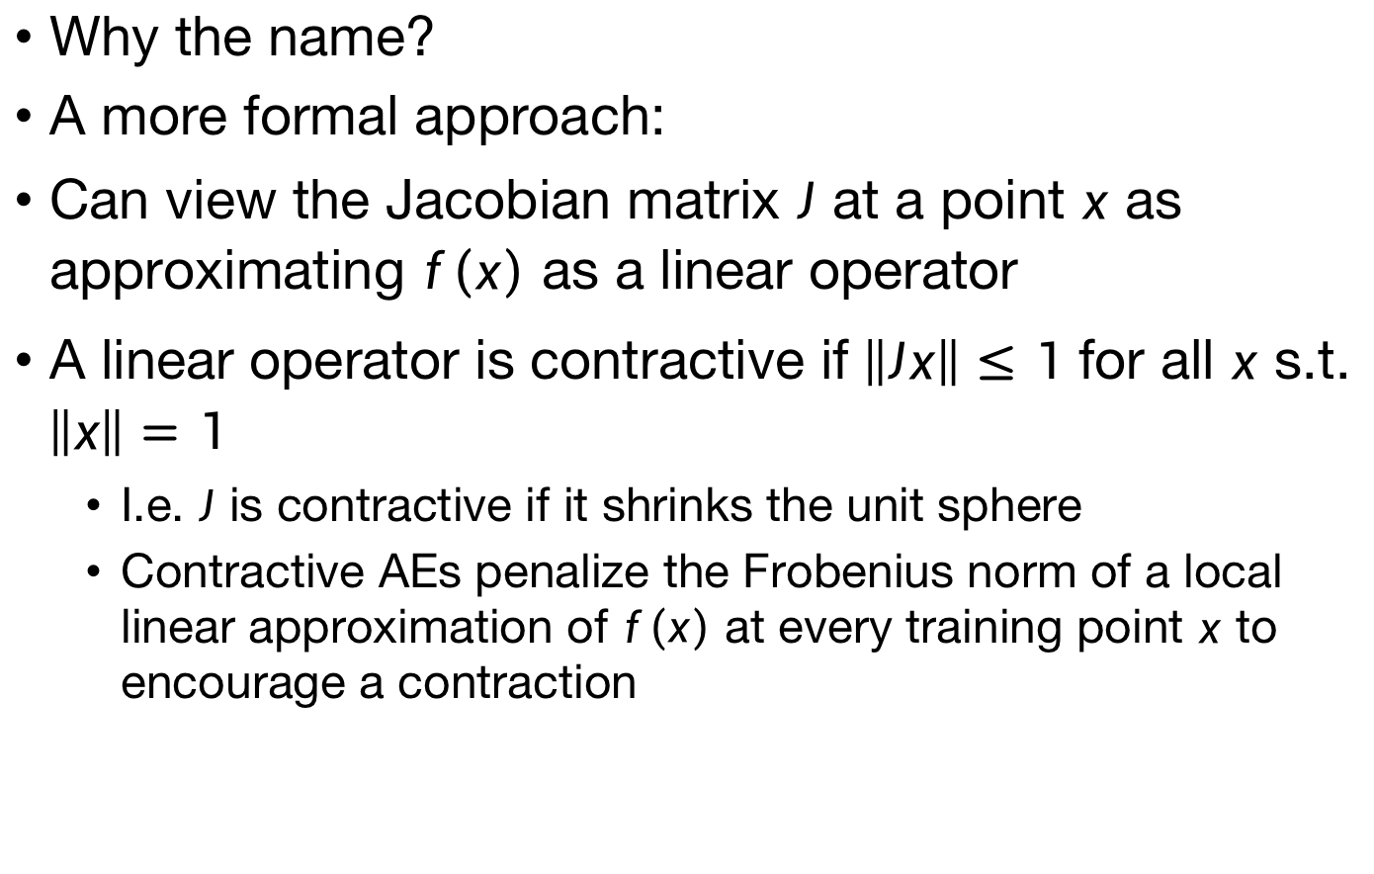
Contractive Autoencoders
Why the name?
A more formal approach:
Can view the Jacobian matrix $J$ at a point $x$ as approximating $f\left(x\right)$ as a linear operator
A linear operator is contractive if $\left\|Jx\right\|≤1$ for all $x$ s.t. $\left\|x\right\|=1$
I.e. $J$ is contractive if it shrinks the unit sphere
Contractive AEs penalize the Frobenius norm of a local linear approximation of $f\left(x\right)$ at every training point $x$ to encourage a contraction

Slide 26
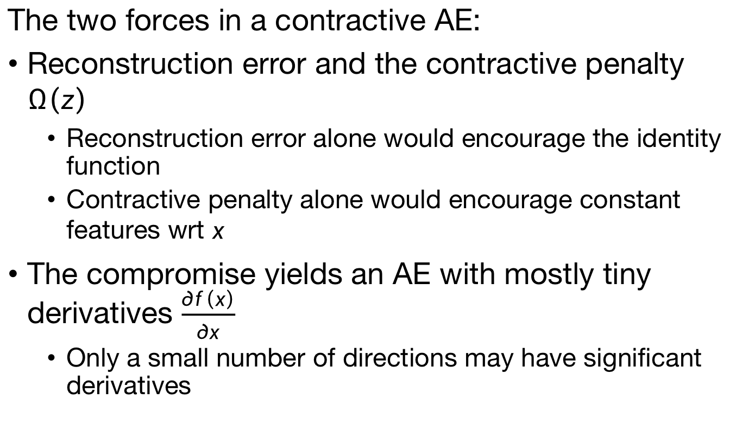
Contractive Autoencoders
The two forces in a contractive AE:
Reconstruction error and the contractive penalty $Ω\left(z\right)$
Reconstruction error alone would encourage the identity function
Contractive penalty alone would encourage constant features wrt $x$
The compromise yields an AE with mostly tiny derivatives $\frac{∂f\left(x\right)}{∂x}$
Only a small number of directions may have significant derivatives

Slide 27
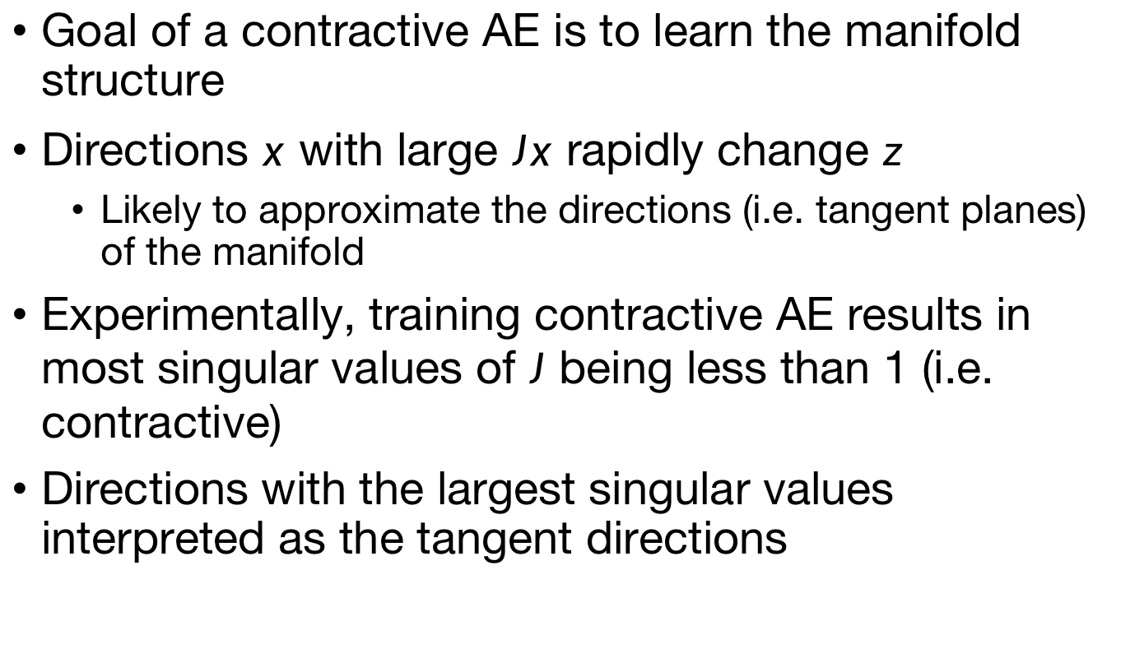
Contractive Autoencoders
Goal of a contractive AE is to learn the manifold structure
Directions $x$ with large $Jx$ rapidly change $z$
Likely to approximate the directions (i.e. tangent planes) of the manifold
Experimentally, training contractive AE results in most singular values of $J$ being less than 1 (i.e. contractive)
Directions with the largest singular values interpreted as the tangent directions

Slide 28
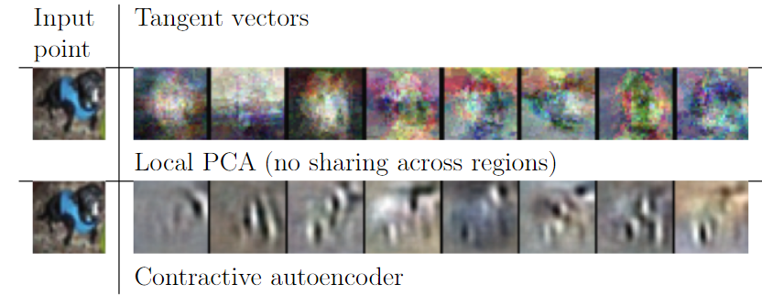
Contractive Autoencoders
Experimentally obtained tangent vectors
Correspond to meaningful transformations

Slide 29
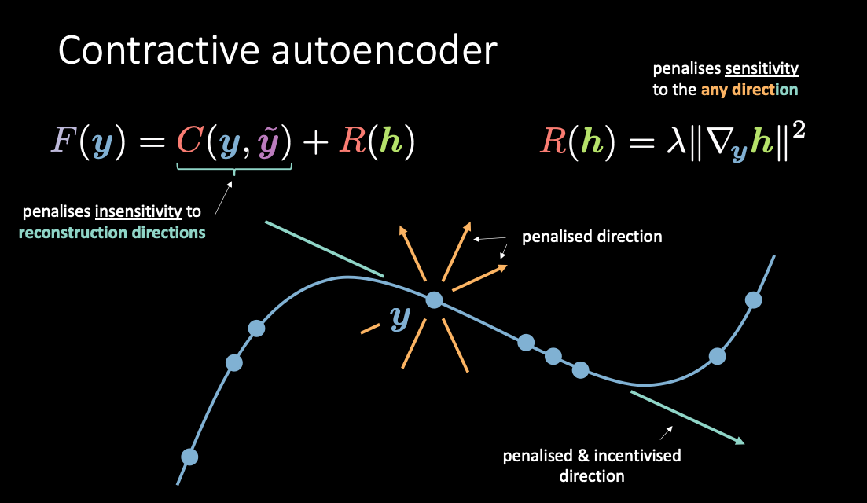
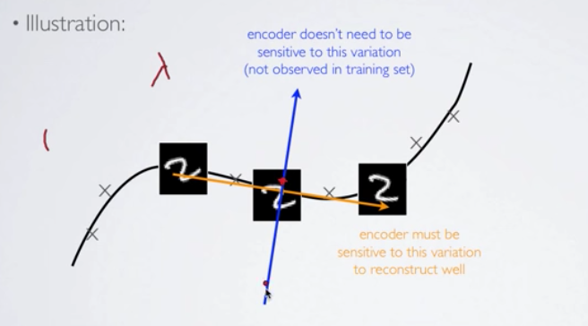
Contractive Autoencoders

Slide 30
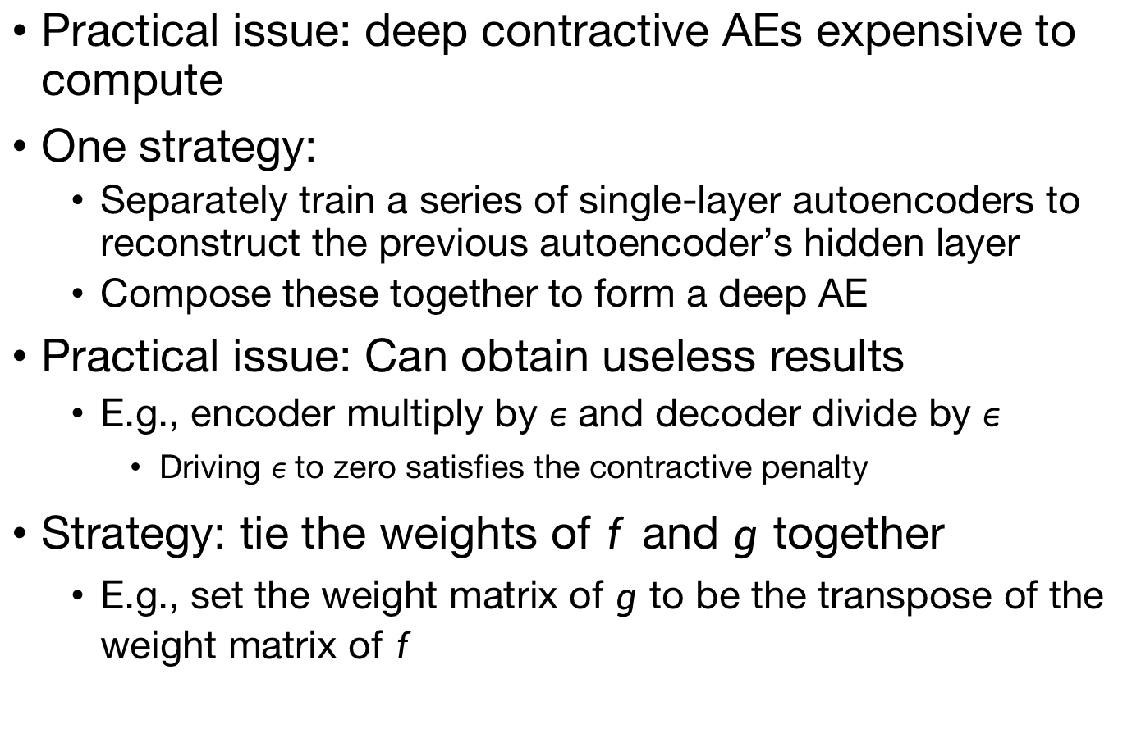
Contractive Autoencoders
Practical issue: deep contractive AEs expensive to compute
One strategy:
Separately train a series of single-layer autoencoders to reconstruct the previous autoencoder’s hidden layer
Compose these together to form a deep AE
Practical issue: Can obtain useless results
E.g., encoder multiply by $ε$ and decoder divide by $ε$
Driving $ε$ to zero satisfies the contractive penalty
Strategy: tie the weights of $f$ and $g$ together
E.g., set the weight matrix of $g$ to be the transpose of the weight matrix of $f$

Slide 31
SAUCIE
Sparse Autoencoder for Clustering Imputation and Embedding (Amodio, van Dijk, Srinivasan et al. 2019, Nature Methods)
Main idea: Let a neural network merge and find emergent patterns in multisample data
Matthew Amodio
David van Dijk
Krishnan Srinivasan
Kevin Moon
Guy Wolf

Slide 32
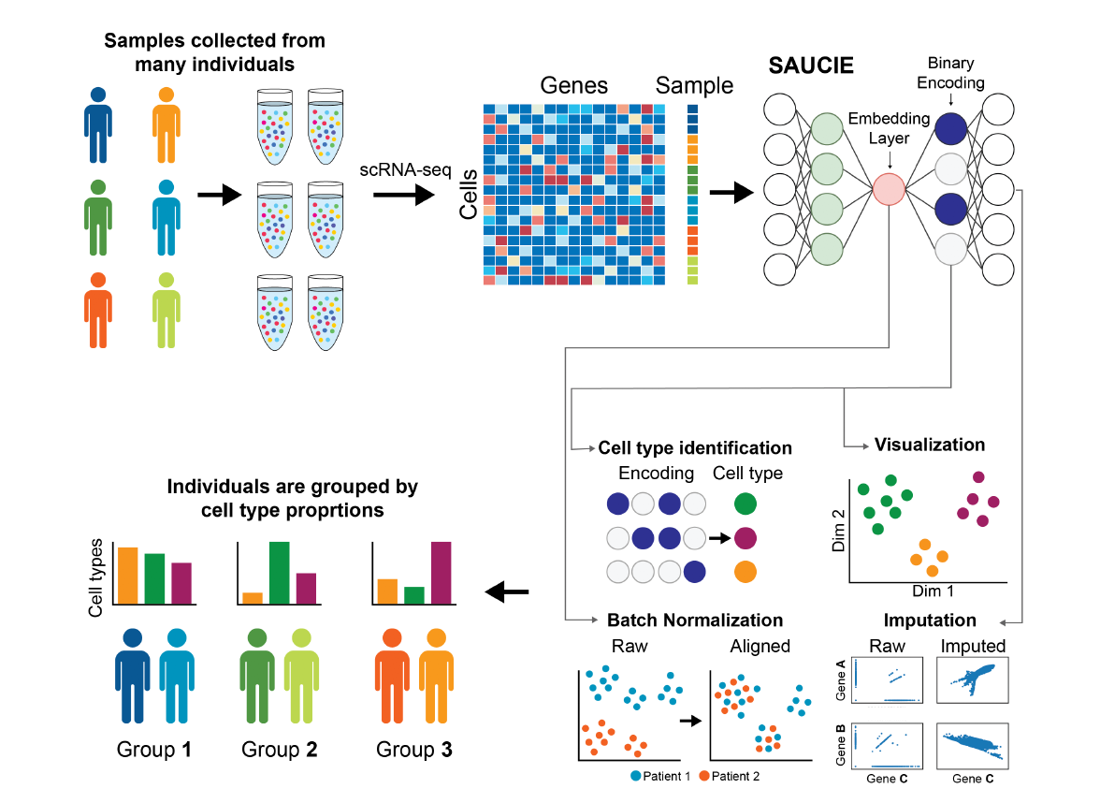

Slide 33
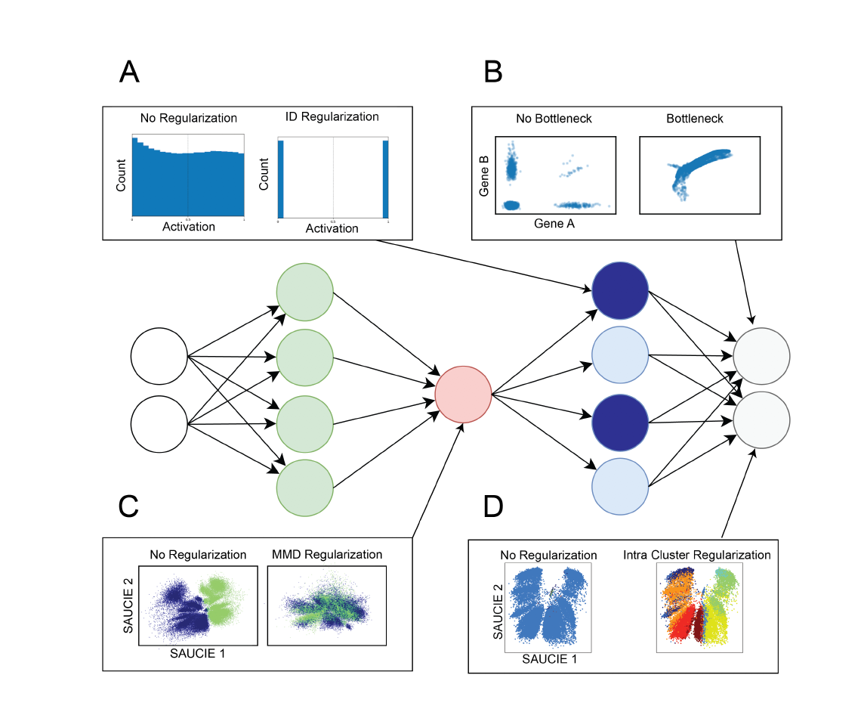

Slide 34
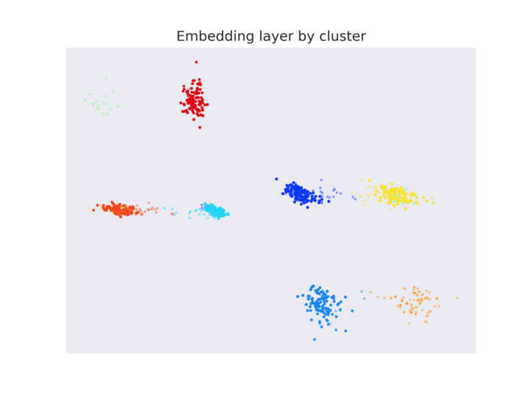
Representation for Clustering
We want: codes for subspaces
Binary activation, good spacing

Slide 35
Clustering: Information Dimension Regularization
High activation entropy
Low activation entropy
Penalty:

Slide 36
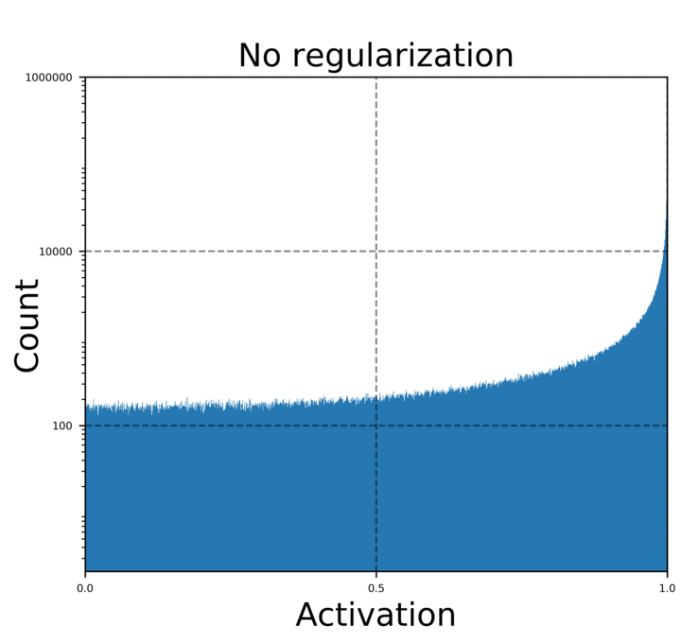
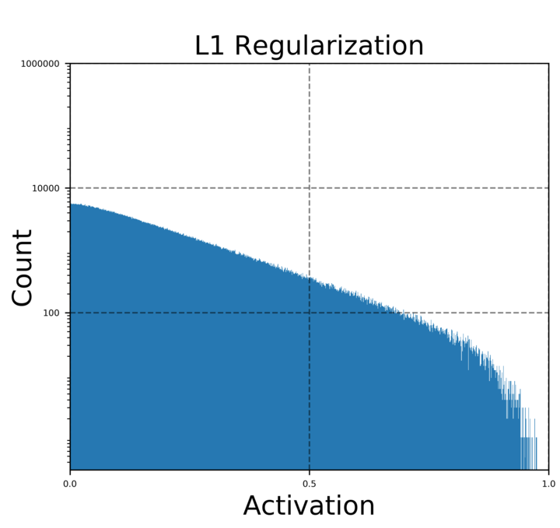
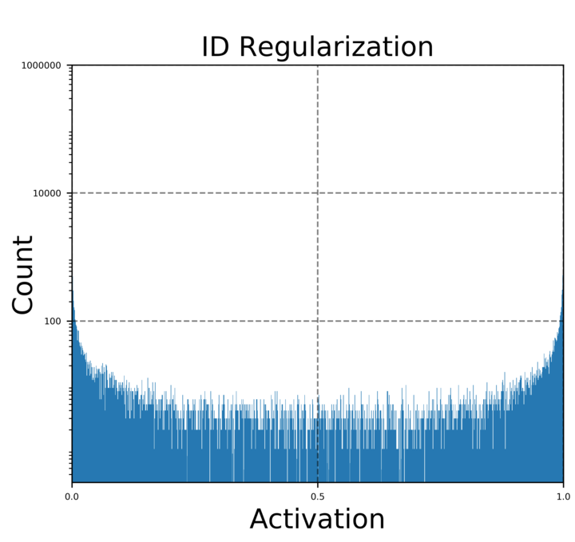
Information Dimension (ID) Regularization
No regularization
L1 regularization
ID regularization
ID regularization enforces a binary-like code

Slide 37
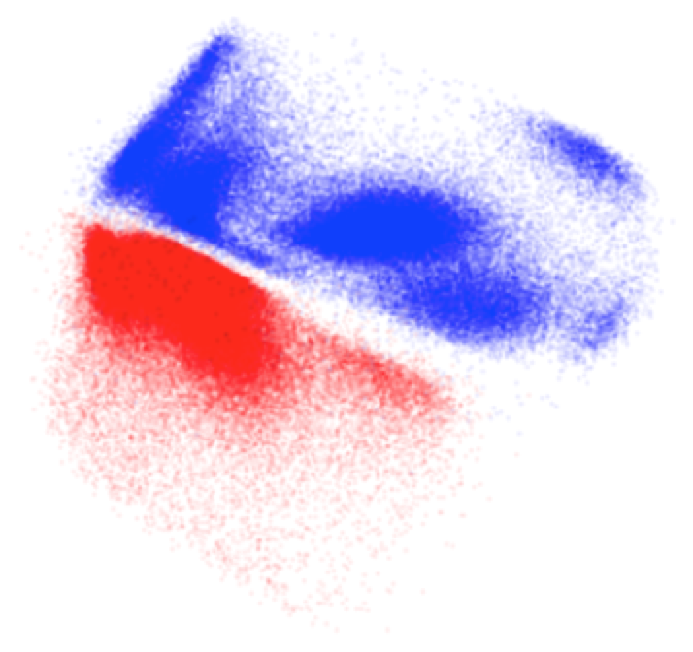
Batch Effects: Manifold Alignment
Patient 1
Patient 2

Slide 38
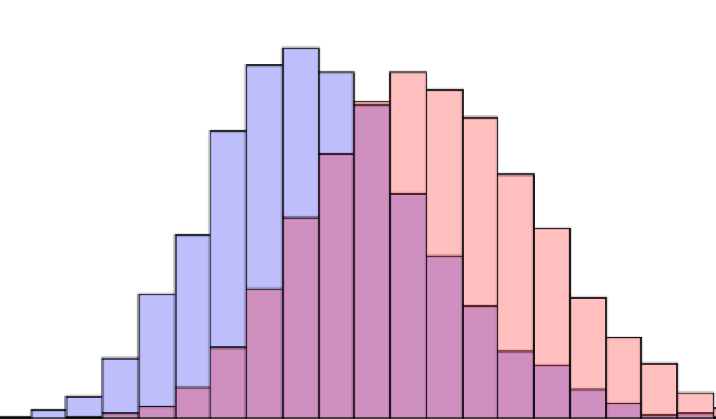
Mean Maximal Discrepancy
[Dziugaite, Roy, Ghahramani, UAI 2015]

Slide 39
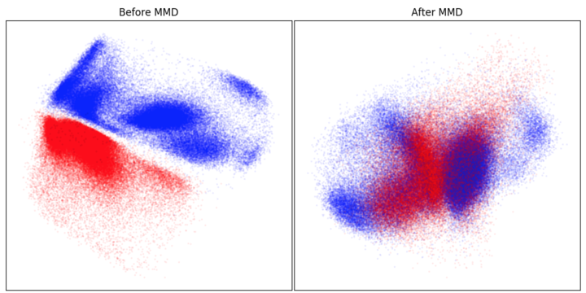

Slide 40
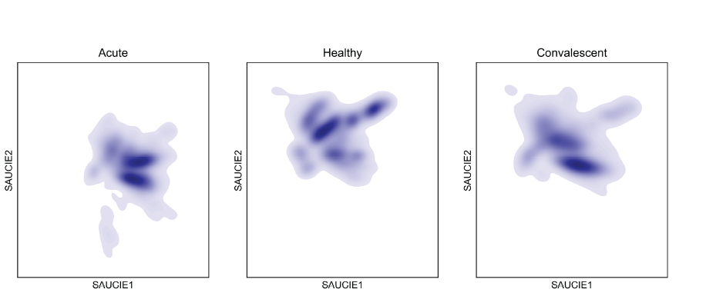
Cellular Manifolds of Dengue Patients

Slide 41
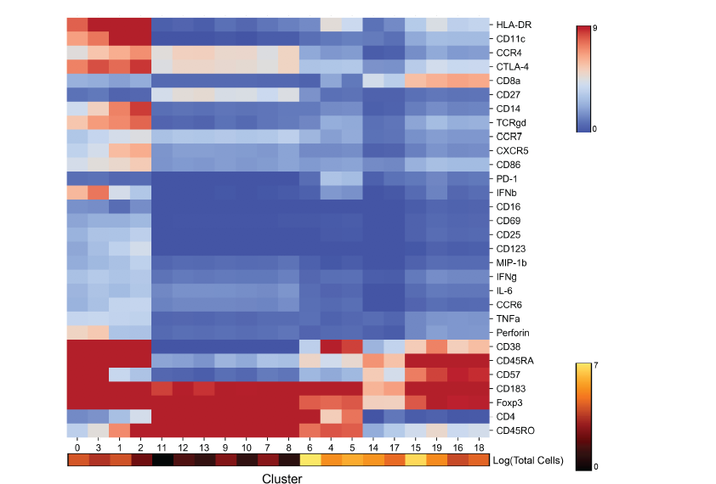
Cell Clusters: 180 Samples Combined

Slide 42
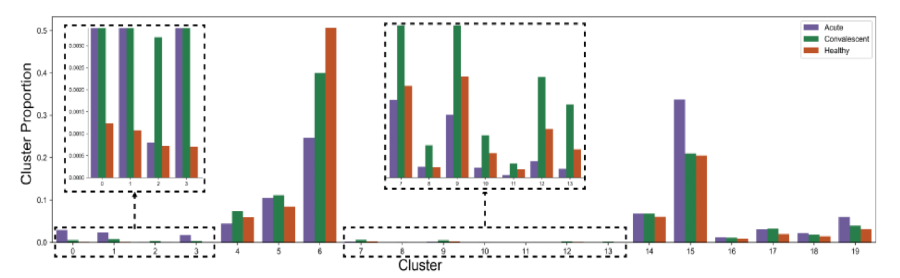
Patient Cluster Signatures
MMD distance can be derived between patient cluster proportions and embedded

Slide 43

Patient manifolds show coherent organization

Slide 44


Slide 45

AAnet
Archetypal Analysis network
(D. van Dijk*, D. Burkhardt*, et al., IEEE Big 2019)
Main idea: Archetypal analysis on non-linear spaces using neural networks
David van Dijk
Dan Burkhardt
Alex Tong
Guy Wolf
Smita Krishnaswamy

Slide 46
Learn non-linear transformation to fit data into convex polytope
Learns each datapoint as an archetypal mixture with mixing coefficients z_{i}

Slide 47

AAnet finds non-linear archetypes

Slide 48

AAnet describes TIL state space

Slide 49

AAnet on gut microbiome samples

Slide 50
Unsupervised Pretraining
Greedy layer-wise unsupervised pretraining
Enabled deep networks for the first time (without special architectures like convolution or recurrence)
A representation learned for one task (unsupervised learning) can be sometimes useful for another task (supervised learning with the same input domain)
Approach: Train a single layer at a time to learn a representation
E.g., use a single layer autoencoder
Each layer is pretrained to take the output of the previous layer and produce a new representation that is simpler
Finally, train the entire network to perform the task

Slide 51

Variational Autoencoders (VAEs)
Standard autoencoder
We want to generate new examples
Can we use an autoencoder?
Notes:
Shifting gears now to generative models
Ask them for any ideas?

Slide 52

Variational Autoencoders (VAEs)
Force the latent vectors to have (roughly) a unit Gaussian distribution
Generate images by sampling a unit Gaussian and passing it into the decoder

Slide 53

Variational Autoencoders (VAEs)
Tradeoff between accuracy and the unit Gaussian approximation
Build this directly into the loss
Kullback-Leibler (KL) divergence: a measure of difference between probability distributions $P$ and $Q$ $$D_{KL}(P|\left|Q\right)=−\sum_{i}{P\left(i\right)\log\left(\frac{Q\left(i\right)}{P\left(i\right)}\right)}$$
Include a regularization term that penalizes the KL divergence between a unit Gaussian and the latent vector distribution
How do we do this in practice?
Notes:
For the continuous version, you can take an integral instead

Slide 54

Variational Autoencoders (VAEs)
1st Epoch
9th Epoch
Original

Slide 55

Variational Autoencoders (VAEs)
2D latent mapping of results from VAEs
Notes:
In this case, the latent variable had two nodes and so these are samples that spanned that 2d space. These are all generated images. For the faces, horizontal corresponds to rotation of the face while vertical corresponds to emotional expression.

Slide 56
Further reading
Goodfellow et al., chapters 14 and 15
Amodio et al. Nature Methods 2019
van Dijk et a. IEEE Big Data 2019
https://jaan.io/what-is-variational-autoencoder-vae-tutorial/
https://towardsdatascience.com/understanding-variational-autoencoders-vaes-f70510919f73
Kingma and Welling Foundations and Trends in ML 2019

